Slide 1
Search Engines and Web Mining
The Islanders
Avlonitis Ektor – 216882
Lazarevic Milos – 272036
Vavakas Alex - 272483

Slide 2
Project Scope
Create an Information Retrieval system:
Crawl through a website to obtain lyrics for songs. We are using the website: https://www.azlyrics.com.
Retrieve relevant lyric documents to a query.

Slide 3
Timeline Infographics
Use S-BERT embedding to improve ranking
Crawl the web – Find song URLs
Step 4
Step 1
Step 3
Step 5
Step 2
Print the most similar songs to the query
Find most similar songs using Tf-idf and cosine similarity
Download lyrics – store them in csv

Slide 4
Crawling the Web – Downloading Data
Libraries used: Beautiful Soup, urrlib, requests, sleep, random and csv
Managed to obtain > 1000 songs.
Scraped URLs 4 times:
Obtained 27 URLs that take us through the artists grouped by the letter their name starts with (navigation bar) → chose randomly 10 letters
For those 10 letters, we obtained the URLs that take us to all artists page → chose randomly 40 artists
For those 40 artists, we obtained the URLs that take us to each artist’s songs with the Lyrics → chose randomly 1500 songs
For these 1500 songs, we obtained the song’s lyrics and stored them in a csv file.

Slide 5
Ranking documents (TF-IDF and cosine similarity)
Libraries used: sklearn (sklearn.feature_extraction.text), nltk (nltk.tokenize, nltk.corpus, nltk.stem)
The steps are:
Preprocessing the documents (stopwords, stemming etc.)
Creating the Term-Document Matrix (Tf-idf method)
Query preparation (same preprocessing)
Calculate cosine similarities
Rank the most similar documents

Slide 6
S-BERT
Chose 50 most similar songs from the last method → stored in a new csv file
We need also a contextual embedding → improve our ranking system
Model for encoding data → Sentence Transformer
SBERT allows the process of two sentences in the same way, simultaneously
Printed top 5 songs using S-BERT

Slide 7
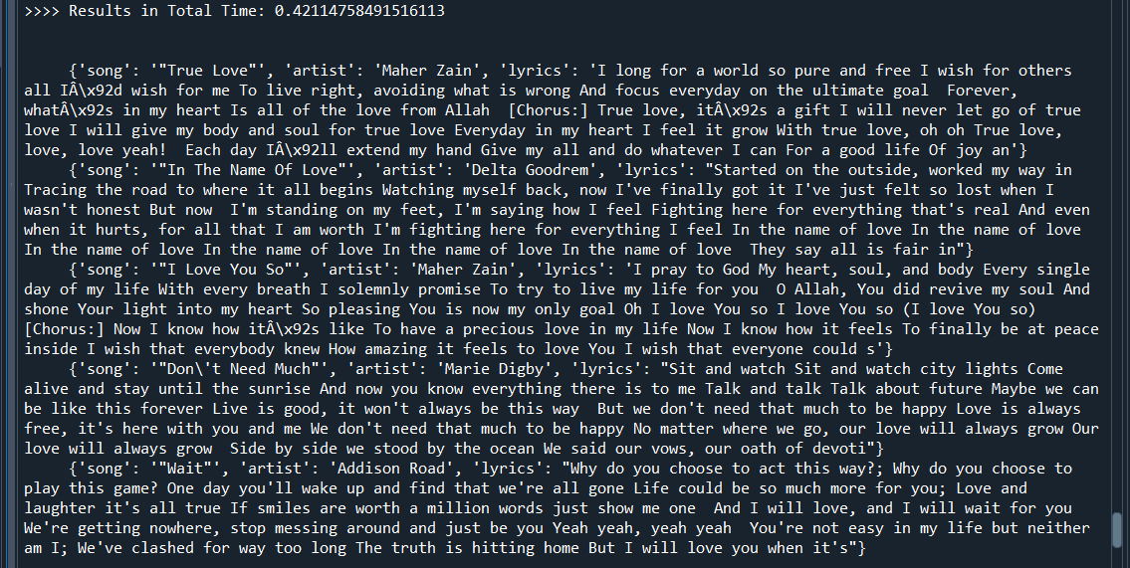
Results
query = “fighting for love”

